Slide 1
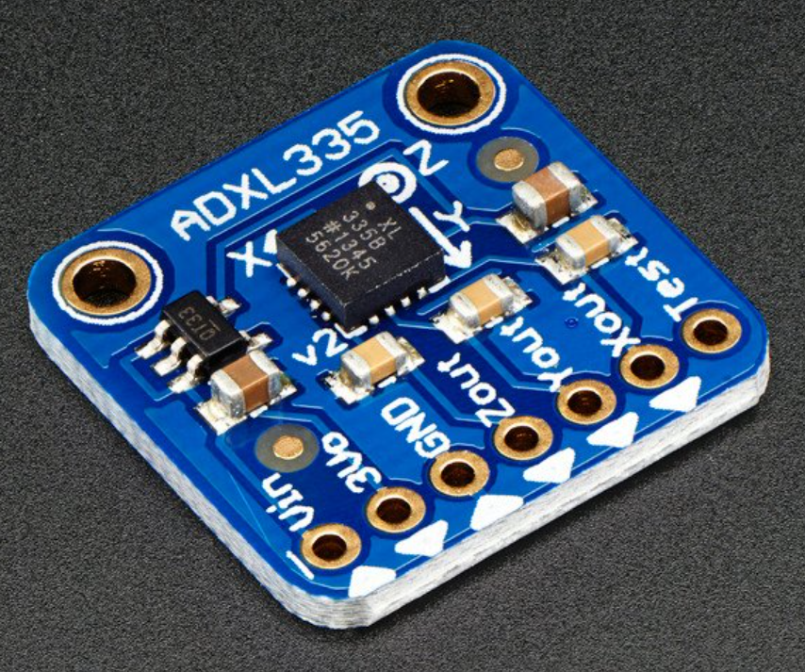
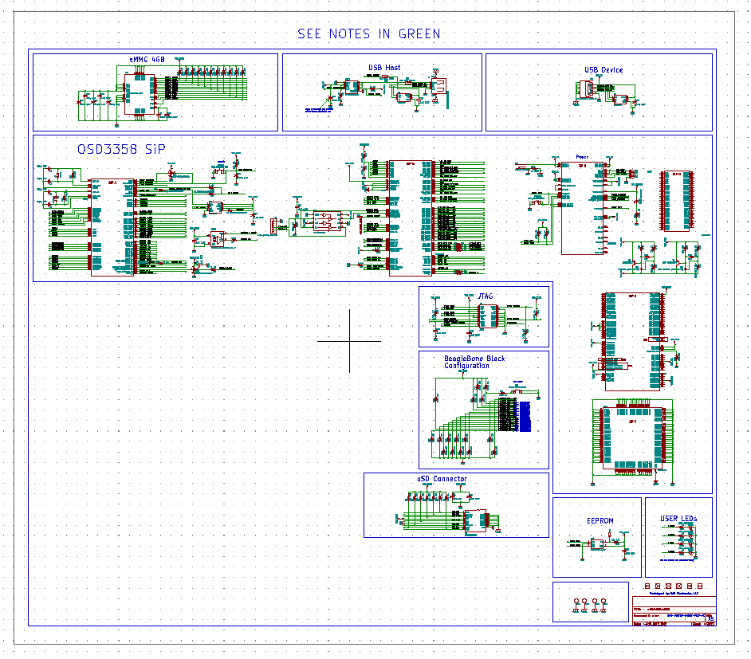
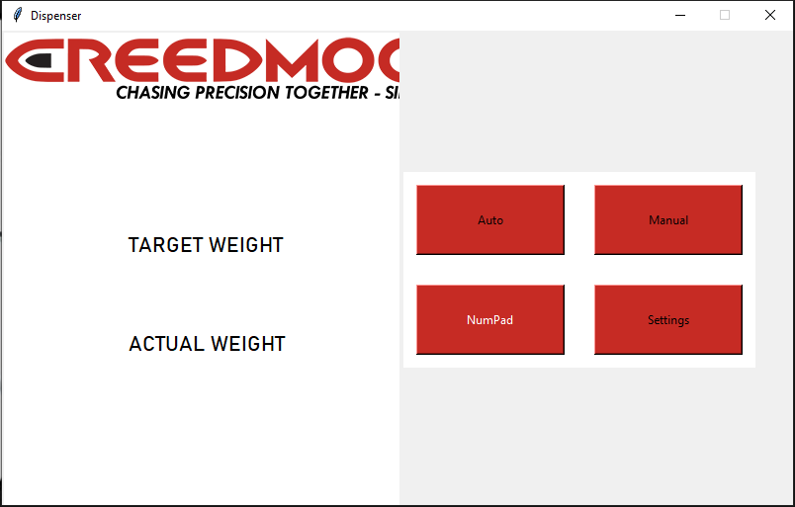
Week 3 (19-Jan to 25-Jan)

Slide 2
Week 3 (19-Jan to 25-Jan) Austin Stecklein
Goal/Task | % Done | Hours (Act.)
Get stepper motor driver working | 80 | 6
Get Code onto the beagle board | 100 | 2
Finish event handler by allowing data to pass from the thread back to the GUI | 100 | 4
Hours on task during the week (On track ≥ (10) / wk) | 12
Total hours on task so far this semester (On track ≥ 36 hrs) | 30

Slide 3
Progress made during the week (Log) (What I did)
Re-flashed memory on the Beaglebone black
Used PWM library to control the stepper motors more accurately
Uploaded code onto the Beaglebone black
Finished backend event framework

Slide 4
Difficulties encountered during the week (What I did not do and why)
Flashing the Board had some hiccups
Understanding the usb capabilities

Slide 5
Goals for this coming week (Ones that move the project forward the most)
Goal/Task | Stop Date (Est.) | Hours (Est.)
Finish stepper motor drivers | 2/2/2022 | 2
Get database framework | 2/2/2022 | 3
Start interfacing with prototype GUI | 2/2/2022 | 6
Estimated time needed to work on goals for this coming week (typ. 13 hrs) | 11

Slide 6
Week 3 (19-Jan to 25-Jan) Colby Hatton
Goal/Task | % Done | Hours (Act.)
Determine Which CAD Software to Use | 90 | 3
Create Basic Schematic and Accustom self to CAD Software | 60 | 5
Find Component Symbols/Footprints | 40 | 5
Hours on task during the week (On track ≥ (10) / wk) | 13
Total hours on task so far this semester (On track ≥ 36 hrs) | ~35

Slide 7
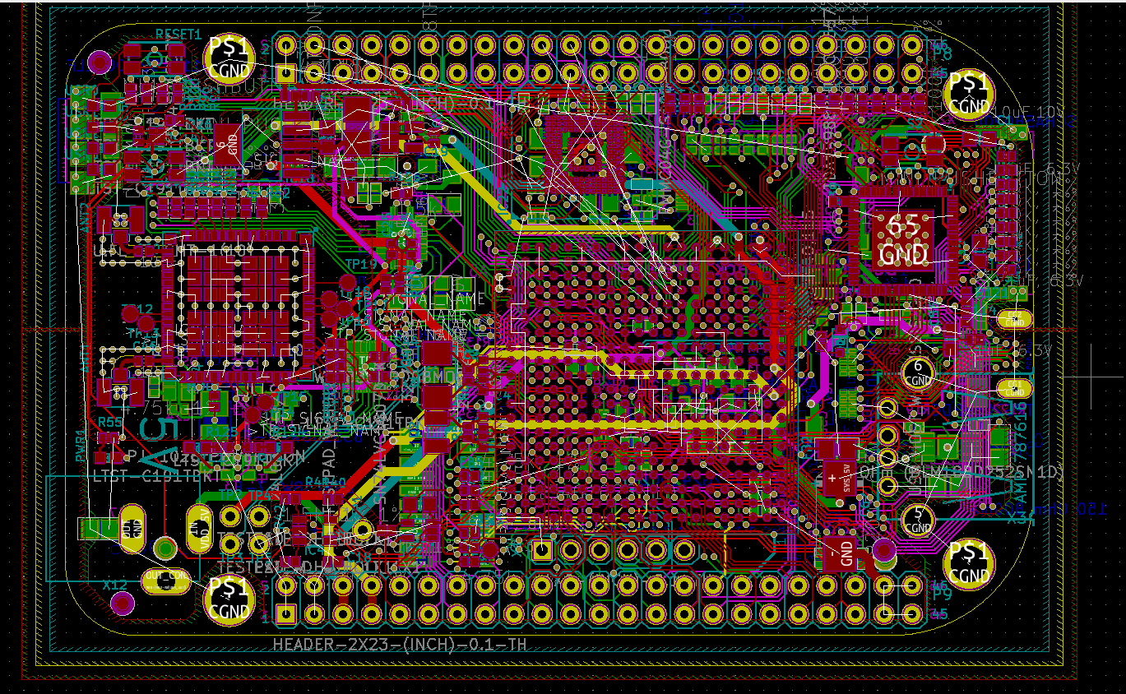
Progress made during the week (Log) (What I did)
Determined that we will be using KiCad to design and lay out our project.
Found Footprint and Symbol Libraries for several components we will be using.
Successfully found and Imported the Beagle Board Black Wireless board and Schematic

Slide 8
Difficulties encountered during the week (What I did not do and why)
Certain components out of production
Need to find alternate and ensure they are compatible with the same pinout

Slide 9
Goals for this coming week (Ones that move the project forward the most)
Goal/Task | Stop Date (Est.) | Hours (Est.)
Acquire footprints/symbols for the components we will be using | 2/9 | 6
Finish/Wire schematic for our PCB | 2/16 | 20
(Possibly) Plan layout of the board | 2/16 | 5
Estimated time needed to work on goals for this coming week (typ. 13 hrs) | ~15

Slide 10
Week 3 (19-Jan to 25-Jan) Dale Andreoli
Goal/Task | % Done | Hours (Act.)
Assist with GUI design/mockup | 90 | 3
GUI – Number pad module | 85 | 8
Project Objective / Mission Statements
Power Scale Dispenser:
Design, build, and test the electronics for the dispenser with a touch screen display and controlling two stepper motors by April 6, 2021 with a prototyping budget of $XXX USD and for less than 600 people-hours.
Hours on task during the week | 11
Total hours on task so far this semester | 30

Slide 11
Progress made during the week (Log) (What I did)
Collaborated with Jonathon on the GUI
Created a Number Pad module that can be easily added into the GUI

Slide 12
Goals for this coming week (Ones that move the project forward the most)
Goal/Task | Stop Date (Est.) | Hours (Est.)
Next GUI module: Pop out menu | 2/1/21 | 8
Collaborate with Jonathan for GUI needs | 2/1/21 | 3
Estimated time needed to work on goals for this coming week | 11

Slide 13
How can we help you achieve your goals?
Jonathan and I will reach out to Christian, Kelby and Wayne for GUI feedback.

Slide 14
Week 3 (19-Jan to 25-Jan) John Stinger
Goal/Task | % Done | Hours (Act.)
Check viability of current accelerometer | 100% | 2
Start the drafting of the circuit board | 100% | 4
Hours on task during the week (On track ≥ (10) / wk) | 6
Total hours on task so far this semester (On track ≥ 36 hrs)

Slide 15
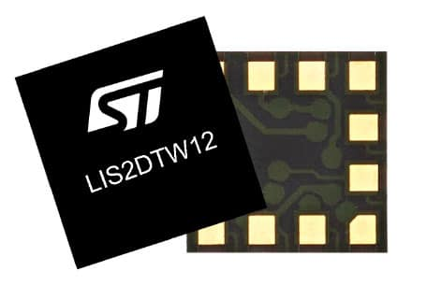
Progress made during the week (Log) (What I did)
For example: Resources found (links, manuals), Designs created, Decisions made and corresponding rational, Photos of prototype progress, etc.
3 axis will be fine
Both the premade card and buying the chip would be viable
Started the modeling with Colby on KiCad

Slide 16
Difficulties encountered during the week (What I did not do and why)
none

Slide 17
Goals for this coming week (Ones that move the project forward the most)
Goal/Task | Stop Date (Est.) | Hours (Est.)
Continue to model the circuit card on the computer. |  | 10+
Learn how to make the motor drivers more robust. |  | 3
Estimated time needed to work on goals for this coming week (typ. 13 hrs)

Slide 18
How can we help you achieve your goals?
Continue to be available for reference.

Slide 19
Week 3 (19-Jan to 25-Jan) Jonathan Phillips
Goal/Task | % Done | Hours (Act.)
UML Mockup | 100 | 1
Front End | N/A | 6.5
Hours on task during the week (On track ≥ (10) / wk) | 8.5
Total hours on task so far this semester (On track ≥ 36 hrs)

Slide 20
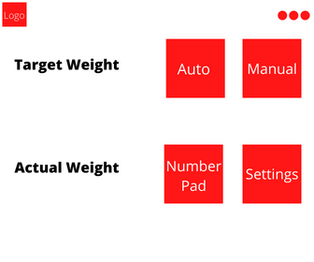
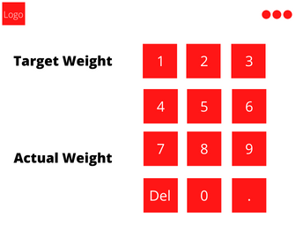
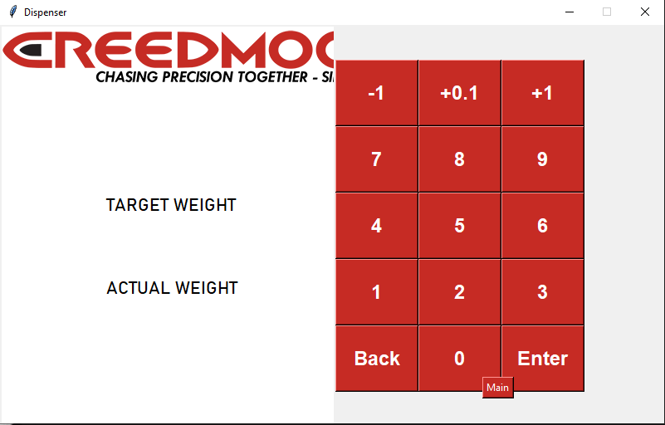
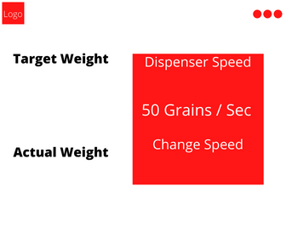
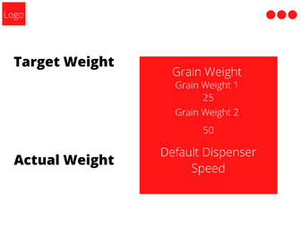
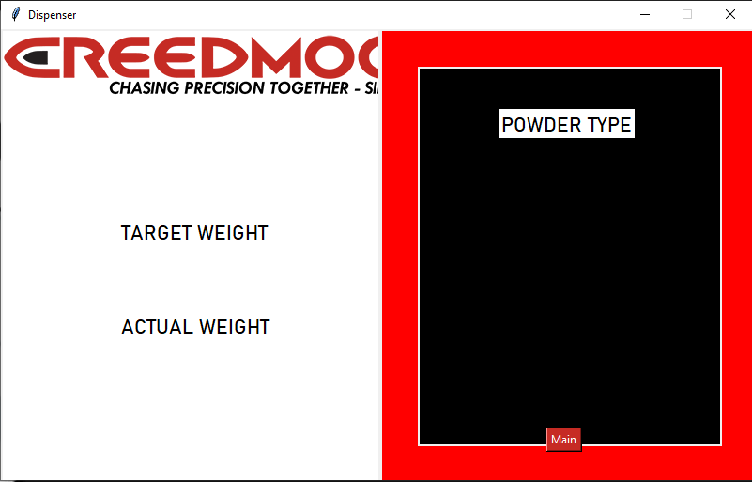
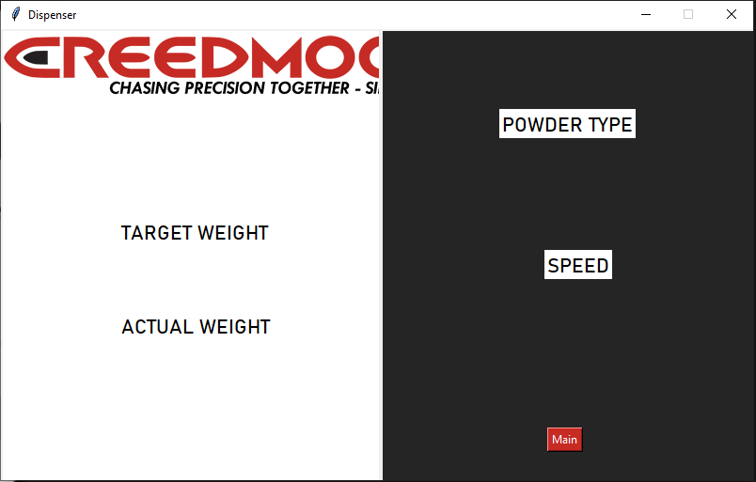
Progress made during the week (Log) (What I did)
UML Mockup
Front end

Slide 21
Difficulties encountered during the week (What I did not do and why)
Learning Python syntax

Slide 22
Goals for this coming week (Ones that move the project forward the most)
Goal/Task | Stop Date (Est.) | Hours (Est.)
Front end | Ongoing | 13
Estimated time needed to work on goals for this coming week (typ. 13 hrs) | 13

Slide 23
How can we help you achieve your goals?
Any comments on the mockup or overall design of the front end?

